Slide 1
Capstone Final Project
Best Neighborhood for Coffee Shops in Toronto

Slide 2
Introduction
The City of Toronto has a population of approximately 2.7 million people. It is the provincial capital of Ontario and the most populous city in Canada. Toronto is an international centre of business, finance, arts, and culture, and is recognized as one of the most multicultural and cosmopolitan cities in the world. The latest demographics show that Toronto consists of approximately 52% visible minorities.
As part of this project, we would like to analyze and visualize the neighborhoods and locations of Toronto that have the most coffee shops.

Slide 3
Data Sources
For this project we need the following data:
List of neighbourhoods and postal codes in Toronto: https://en.wikipedia.org/wiki/List_of_postal_codes_of_Canada:_M
List of postal codes and latitude longtitude coordinates:
https://cocl.us/Geospatial_data
List of coffee shops restaurants in each neighbourhood in Toronto: Foursquare API

Slide 4
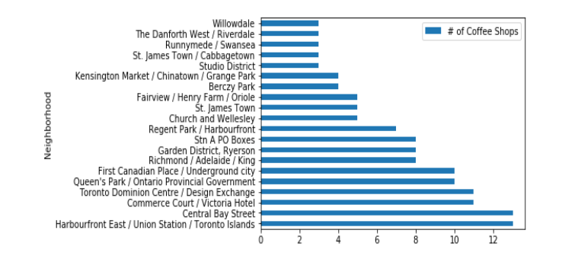
Results

Slide 5
Conclusion
For the problem at hand, the neighborhood(s) in Toronto which contain the most coffee shops are Harbourfront East / Union Station / Toronto Islands, and Central Bay Street, each with 13.

